Slide 1
K = 273 + C C = 5/9(F-32) F = 9/5C + 32
100 C 373 K 212 F ___◦G (B.Pt.)
0 C 273 K 32F ___◦G (F.Pt.)
-273 C 0 K -459.4F
Problem 1.66
Hint:
The proportions
5/9 & 9/5 in the
◦C to ◦F conversions are derived from
the proportions of their temperature scale increments (100/180 & 180/100). You can utilize this method to derive new equations for
the ◦C to ◦G conversion.
100 increments
100 increments
180 increments

Slide 2
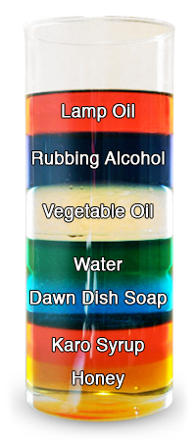
Problem 1.67
Density of common substances
Hint:
Less dense substances rise to float above more dense substances
...usually. Ice floats
in water which is an
exception to what
we would normally
observe since most solids usually sink in their liquid.
Air = 0.0013 g/mL O₂ = 0.0029 g/mL H₂ = 0.00089 g/mL Water = 0.998 g/mL Alcohol = 0.791 g/mL Milk = 1.031 g/mL Ice = 0.92 g/cm³ Sugar = 1.59 g/cm³ Diamond = 3.26 g/cm³ Copper = 8.92 g/cm³ Lead = 11.35 g/cm³

Slide 3
Problem 1.72
Hint:
Battery acid solution:
solute = H₂SO₄
solvent = water
mass solute
% by mass = x 100
mass solution
D = m
v

Slide 4
Problem 1.75
Hint:
Example of converting units:
1.53 km² = ____ m²
equality: 1 km = 10³ m
square 2 2
both sides: 1 km = 10³ m
1 km² = 10⁶ m²
Solve: 1.53km² 10⁶m² = 1.53x10⁶ m²
1km²
Converting cubic & squared units:
1. Define the equality of simple units
2. Define conversion factor by cubing or squaring
both sides
Solve
D = m/v
cubic volume = l x w x h
Step 1
Step 2
Step 3

Slide 5
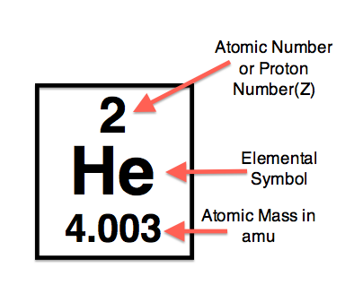
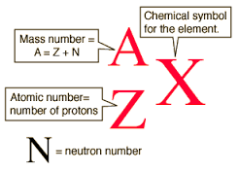
Problem 2.87
Isotope | Protons | Electrons | Neutrons | Atomic Number | Atomic Mass | Mass Number
35 20 | 20 | 18 | 15 | 20 | 40.08 | 35
Ca²⁺
Standard
Nuclear Notation

Slide 6
Problem 2.90
Average Atomic Mass
Isotope | Mass (amu) | Relative Abundance (%)
Cr – 50 | 49.946 amu | 4.3500 %
Cr – 52 | 51.941 amu | 83.800 %
Cr – 53 | 52.941 amu | 9.5000 %
Cr – 54 | 53.939 amu | 2.3500 %
Avg. Atomic Mass = (mass Cr-50)(%) + (mass Cr-52)(%) + (mass Cr-53)(%) + (mass Cr-54)(%)
(49.946)(0.043500) = 2.1727
(51.941)(0.83800) = 43.527
(52.941)(0.095000) = 5.0294
(53.939)(0.023500) = 1.2676
Avg Atomic Mass = 2.1727 + 43.527 + 5.0294 + 1.2676 = 51.996 amu

Slide 7
Problem 2.98, 2.102, 2.104
Ionic Molecular Acids
*metal/nonmetal *nonmetals only
*cation/anion
*use criss-cross method
Ternary Acids Polyatomic Ion Acid Name Name |  | Binary Acids prefix + nonmetal + “-ic” “hydro” root ending name
Hypo____ite | Hypo___ous Acid
____ite | ____ous Acid
____ate | ____ic Acid
Per____ate | Per____ic Acid
CO₃²⁻ , Carbonate
CrO₄²⁻ , Chromate
Cr₂O₇²⁻ , Dichromate
SiO₃²⁻ , Silicate
PO₃³⁻ , Phosphite
PO₄³⁻ , Phosphate
NH₄⁺ , Ammonium
BrO₃⁻ , Bromate
BrO₂⁻ , Bromite
H₂PO₄⁻ , dihydrogen phosphate NO₃⁻ , Nitrate ClO₃⁻ , Chlorate
C₂H₃O₂⁻ , acetate CN⁻ , Cyanide ClO₄⁻ , Perchlorate
HSO₃⁻ , Hydrogen sulfite (bisulfite) OH⁻ , Hydroxide HPO₄²⁻ , Hydrogen phosphate
HSO₄⁻ , Hydrogen sulfate (bisulfate) MnO₄⁻ , Permanganate C₂O₄²⁻ , Oxalate
HCO₃⁻ , Hydrogen carbonate ClO⁻ , Hypochlorite SO₃²⁻ , Sulfite
(bicarbonate) ClO₂⁻ , Chlorite SO₄²⁻ , Sulfate
NO₂⁻ , Nitrite

Slide 8
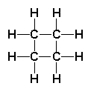
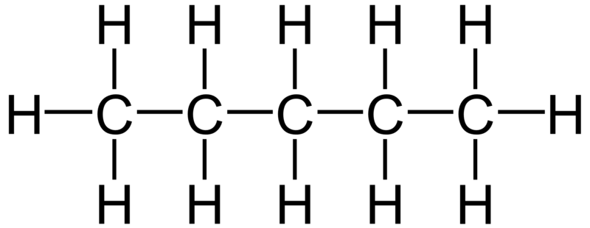
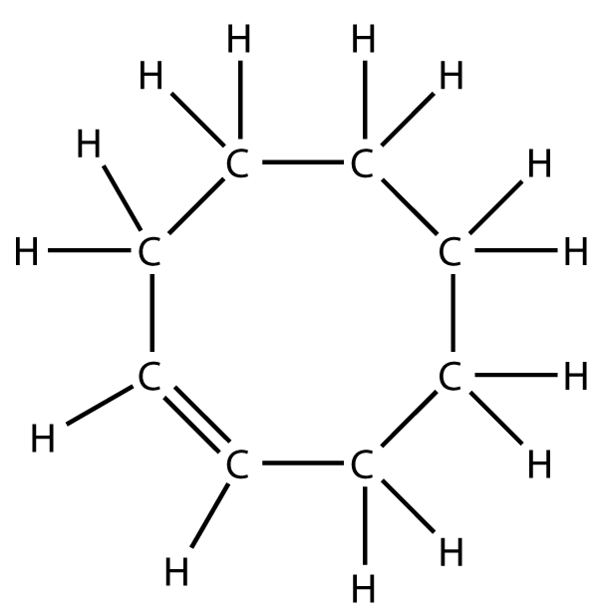
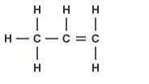
Problem 2.105
Hydrocarbon Prefixes 1 - meth 2 – eth 3 – prop 4 – but 5 – pent 6 – hex 7 – hept 8 – oct 9 – non 10 - dec
Carbon has 4 valence e’s & forms 4 bonds
Saturated
Cyclobutane, C₄H₈
Saturated
(all C’s have 4 single bonds)
Pentane = C₅H₁₂
Hydrocarbon Suffixes Single bond = “-ane” Double bond = “-ene” Triple bond = “-yne”
Unsaturated
Cyclooctene, C₈H₁₄
Unsaturated
(all C’s have 4 bonds…but not all are single)
Propene = C₃H₆

Slide 9
Problem 3.82
Mass of Element
percent by mass = x 100
Mass of Compound

Slide 10
Problem 3.87 a
Example:
What is the empirical formula of a compound that contains:
32.38% Na, 22.65% S, and 44.99% O
32.38 g Na 1 mole Na
= 1.408 mol Na
22.99 g Na
22.65 g S 1 mole S
= 0.7063 mol S
32.07 g S
44.99 g O 1 mole O
= 2.812 mol O
16.00 g O
1.408 0.7063 2.812
= 1.993 = 1 = 3.981
0.7063 0.7063 0.7063
Guidelines to determine
empirical formula?
-Calculate % composition (if necessary)
-Assume you have 100g of sample and
substitute “grams” for “%’s”
-Convert “grams” to “moles”
-Divide all “mole” amounts by the smallest
amount of “moles” determined.
-Special rounding rules. Round to a whole
number only if the tenths digit ends in
0,1,or 9
Empirical Formula = Na₂SO₄

Slide 11
Problem 3.99 a,b,c--only do C₂H₂ for part c
Example: If 2.0mol of HF react with 4.5mol of SiO₂,
which is the limiting reactant (LR) ?
SiO₂ + 4HF → SiF₄ + 2H₂O
(4.5mol) (2.0mol)
2.0mol HF 1mol SiO₂
= 0.50 mol SiO₂
4mol HF
4.5mol SiO₂ 4mol HF
= 18 mol HF
1mol SiO₂
_{Limiting} _{Reactant = HF}
Things to remember w/stoichiometry:
-Amount of product produced is always
dependent on the LR
-The term “excess” stated in a problem
eliminates the need to calculate the LR.
Amounts you have
for reaction
Amounts you need
for reaction
Is the amount you HAVE enough
to cover the amount you NEED?

Slide 12
Problem 4.92 Q1, Q2, Q3
Solubility Rules
Compounds | Solubility | Exceptions
1. Salts of alkali metals (group 1A metals), and ammonia (NH₃) | Soluble | Some compounds of Li.
2. Nitrates and Chlorates | Soluble | Few exceptions.
3. Sulfates | Soluble | Compounds of Pb, Ag, Hg, Ba, Sr, & Ca.
4. Chlorides | Soluble | Compounds of Ag & some compounds of Hg & Pb.
5. Carbonates, phosphates, chromates, sulfides, and hydroxides | Most are insoluble | Compounds of the alkali metals (group 1A metals) & of ammonia (NH₃).
Strong Weak Strong Weak
Acid Acid Base Base
H₂SO₄ HSO₄⁻ Ca(OH)₂ NH₃
HClO₄ H₃PO₄ Sr(OH)₂ C₆H₅NH₂
HCl HF Ba(OH)₂
HNO₃ CH₃COOH NaOH
HBr H₂CO₃ KOH
HI H₂S RbOH
HCN CsOH
HCO₃⁻
Ionic Equation Reminders:
-Solids (s) and weak electrolytes do not get “broken apart” to
be shown as ions in the complete ionic equation.
-Spectator ions are not included in net ionic equation
Cl⁻
OH⁻
Cu²⁺ Na⁺
CuCl₂(aq) + 2NaOH(aq) → Cu(OH)₂(s) + 2NaCl(aq)
Cu²⁺(aq) + 2Cl⁻(aq) + 2Na⁺(aq) + 2OH⁻(aq) → Cu(OH)₂(s) + 2Na⁺(aq) + 2Cl⁻(aq)
Cu²⁺(aq) + 2OH⁻(aq) → Cu(OH)₂(s)

Slide 13
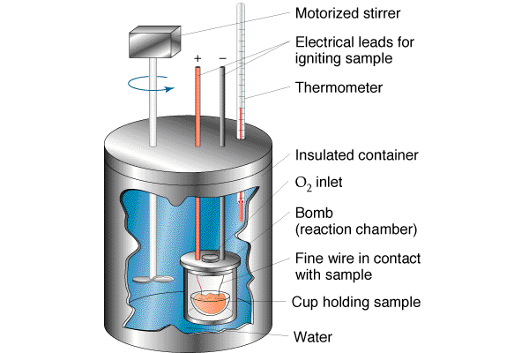
Problem 5.98 a
=
q_{lost} by metal q_{gained} by H₂O
q_{metal} = m_{metal}CP_{metal}∆T_{metal} q_{H2O} = m_{H2O}CP_{H2O}∆T_{H2O}
q = C_{p} m ∆T
q = heat
C_{p} = specific heat
m = mass
T = (T_{final} – T_{initial})

Slide 14
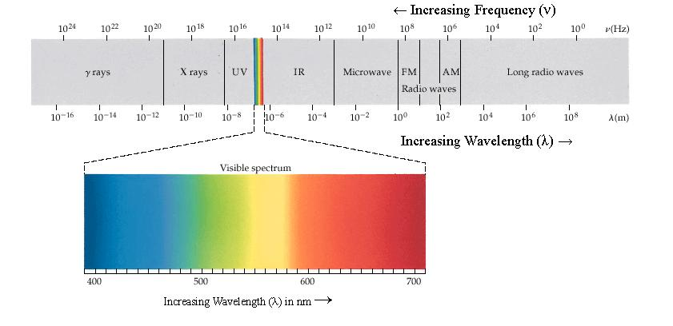
Problem 6.15 a, b, c
tera (T) | 10¹²
giga (G) | 10⁹
mega (M) | 10⁶
kilo (k) | 10³
hecto (h) | 10²
deka (da) | 10¹
BASE UNITS: meter , gram , Liter, etc. 10⁰
deci (d) | 10⁻¹
centi (c) | 10⁻²
milli (m) | 10⁻³
micro (μ ) | 10⁻⁶
nano (n) | 10⁻⁹
pico (p) | 10⁻¹²
femto (f) | 10⁻¹⁵
atto (a) | 10⁻¹⁸
c = λ ν
c = speed of light = 3.0x10⁸ m/s
λ = wavelength--units in meters
ν = frequency—units are Hertz or s⁻¹

Slide 15
Problem 6.73 a, b, c
1s² 2s² 2p⁶ 3s² 3p⁶ 3d¹⁰ 4s² 4p⁶ 4d¹⁰ 4f¹⁴ 5s² 5p⁶ 5d¹⁰ 5f¹⁴ 6s² 6p⁶ 6d¹⁰ 7s² 7p⁶
Order from left to right: 1s²2s²2p⁶3s²3p⁶3d¹⁰4s²4p⁶4d¹⁰4f¹⁴…..NO!!!!!
INCORRECT
Order following diagonal arrows: 1s²2s²2p⁶3s²3p⁶4s²3d¹⁰4p⁶5s²4d¹⁰5p⁶…..YES!!!!
CORRECT
Aufbau Principle…order of the arrows
Pauli Exclusion Principle…e’s have opposite spins in orbitals
Hund’s Rule…fill only 1 e per orbital at a time

Slide 16
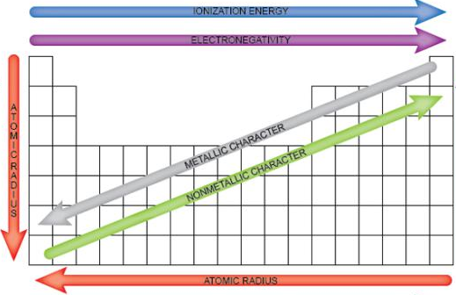
Problem 7.45 a-e
Hint:
Arrows indicate
direction of increasing trend

Slide 17
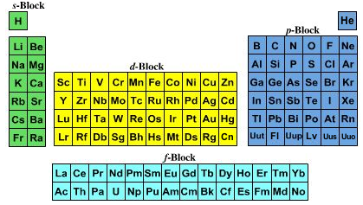
Problem 7.48 a , b
Hint:
e’s get removed from the
outermost energy level first ,
regardless of the order of the
configuration
*Question 7.48 refers to
determining which ions have
a configuration that matches
that of one of the noble gas
elements.
Electron configuration for Sc: 1s² 2s² 2p⁶ 3s² 3p⁶ 4s² 3d¹ Noble-Gas Configuration for Sc: [Ar] 4s² 3d¹ Configuration for Sc ¹⁺ : 1s² 2s² 2p⁶ 3s² 3p⁶ 4s¹ 3d¹
21
Sc
44.95
4s²
3s²3p⁶3d¹
n=4 is the highest
energy level,
therefore the 4s²
electron is the one
that gets removed
To form Sc⁺
2s²2p⁶
1s²

Slide 18
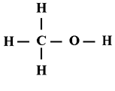
Problem 8.88 a
Lewis Structures
-Determine number of valence e’s.
-Form skeleton structure.
-All elements should have 8 e’s except for Hydrogen
…form double or triple bonds if necessary to help all
atoms except H get 8 e’s.
..
..
Calculating Formal Charge
C_{f} = X – (Y + Z/2)
X = the number of valence e’s in the free atom
Y = the number of unshared e’s owned by the
atom in the Lewis structure
Z = the number of e’s that the atom shares with
other atoms it is bonded to in the Lewis structure
For C: X=4, Y=0, Z=8 C_{f} = 4 – (0 + 8/2) = 0
For O: X = 6, Y = 4, Z = 4 C_{f} = 6 – (4 + 4/2) = 0

Slide 19

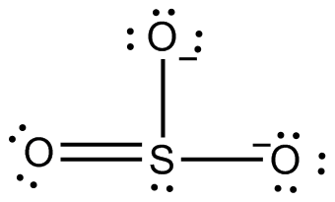



Problem 9.79 b, c
Sigma Bonds (σ) & Pi Bonds (π)
*All single bonds are σ
*In multiple bonds, one bond
is σ & all others are π .

Slide 20
Problem 10.91 & 10.93
Hint:
Make sure units are consistent for all variables.

Slide 21
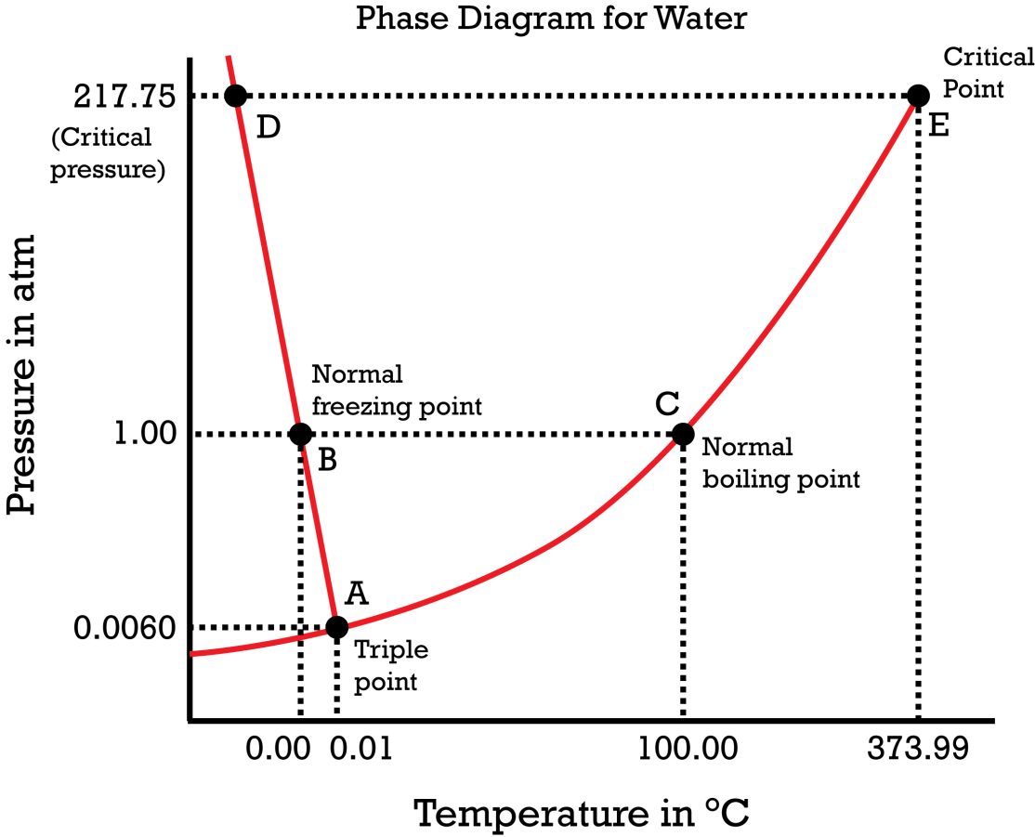
Problem 11.56 a
Triple Point
Critical Point
Critical Temperature (t_{c})
Critical Pressure (p_{c})
Supercritical State
liquid
Hint:
Normal BP and FP
occur at 1 atm
solid
gas

Slide 22
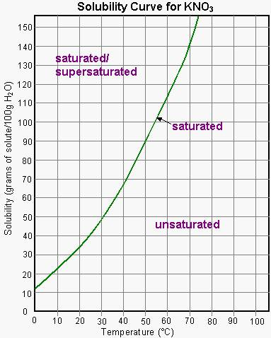
Problem 13.24 a
Solubility Value = grams of solute per 100 g of H₂O at 20°C
*Temp must be specified.
*Pressure must be specified for gases.
*20°C is room temperature.

Slide 23
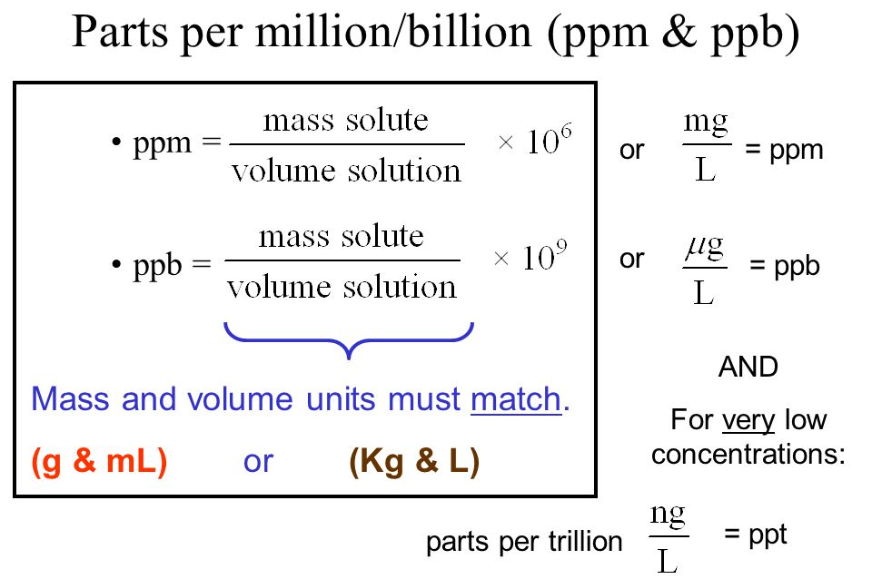
Problem 13.89 a

Slide 24
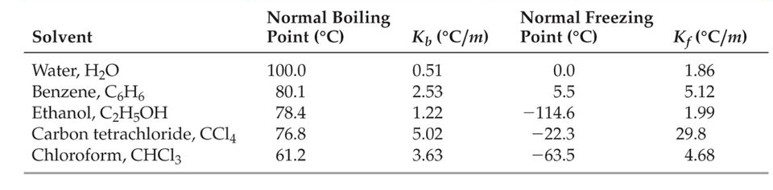
Problem 13.69 a
# moles solute
Molality(m) = ----------------------
# kg of solvent
Chart of Molal BP Elevation & FP Depression Constants for Solvents
∆T_{f} = k_{f} m
∆T_{b} = k_{b}m
HINT:
Remember to choose the
k_{f} & k_{b} value for the solvent
… not the solute.

Slide 25
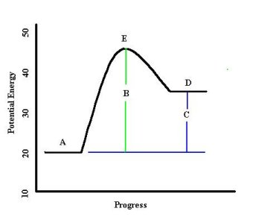
Problem 14.7
E_{a} = (point E – point A) = (45-20) = 25 kJ
E_{a}’ = (point E – point D) = (45-35) = 10 kJ
∆E_{forward} = (product – reactant) = (35-20) = 15 kJ
∆E_{reverse} = (product – reactant) = (20-35) = -15 kJ
for forward reaction for reverse reaction
A = reactant A = product
B = activation energy(E_{a}) B = n/a…but E-D is E_{a}’
C = ∆E_{(product-reactant)} C = ∆E_{(product-reactant)}
D = product D = reactant
E = activated complex E = activated complex

Slide 26
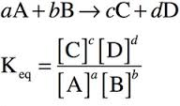
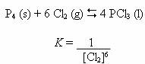
Problem 15.14 a, b
Law of Mass Action
Hints:
*only substances having physical states
of (aq) and (g) can be included in the
equilibrium expression.
*homogeneous equilibria means all physical
states in the equation are the same…
heterogeneous means the states vary
example:

Slide 27
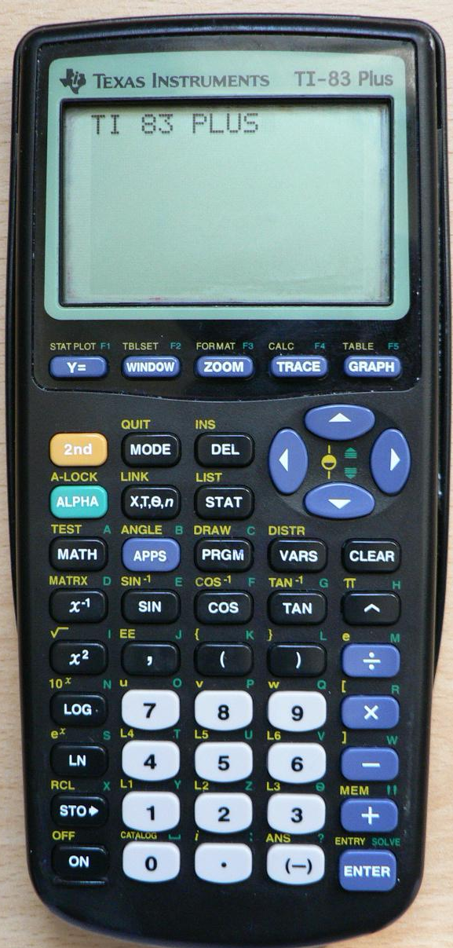
Problem 16.39 (1st row only)
Hint:
*You can use the inverse log function on
your calculator to determine [H₃O⁺] or
[OH⁻] if you are provided pH or pOH.
…for TI-84 Plus graphing calculator use
the following method:
2nd log (-) pH or pOH value
K_{w} = [H₃O⁺] [OH⁻] = 1 x 10⁻¹⁴ M
pH = -log[H₃O⁺]
pOH = -log[OH⁻]
pH + pOH = 14.0
10^{x}
ANS ?
Example:
pH = 12.9 = -log[H₃O⁺]
10^{-12.9} = [H₃O
1.259x10⁻¹³ = [H₃O⁺]

Slide 28
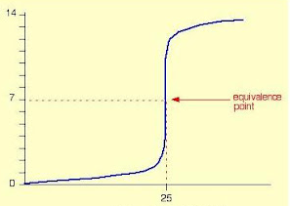
Problem 17.6 a , b, c , d
Hint:
*determine whether you are titrating with an acid
or base by analyzing the titration curve to see if the
solution starts acidic and then becomes more basic
or vice versa.
Titration Combination | Equivalence Point
Strong acid titrated w/strong base | Equivalence point is pH = 7
Strong acid titrated w/weak base | Equivalence point is pH < 7
Weak acid titrated w/strong base | Equivalence point is pH > 7
Strong base titrated w/strong acid | Equivalence point is pH = 7
Strong base titrated w/weak acid | Equivalence point is pH > 7
Weak base titrated w/strong acid | Equivalence point is pH < 7
pH
Volume of base added

